Slide 1
Rock and Roll Is Here to Stay!
Intro: Rock (Rock, Rock) Oh Baby (4X)
Verse 1: Rock and roll is here to stay, it will never die.
It was meant to be that way, though I don't know why.
I don't care what people say, rock and roll is here to stay.
We don't care what people say, rock and roll is here to stay.
Verse 2: Rock and roll will always be, I dig it to the end.
It'll go down in history, just you watch my friend.
Rock and roll will always be, it'll go down in history. (2X)
Call: Everybody Rock! (4X) Response: Everybody rock and roll! (3X)
ROCK ON! Everybody Rock!
Intro: Rock (Rock, Rock) Oh Baby (3X) Rock
Rock and Roll!

Slide 2
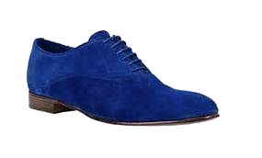
Blue Suede Shoes
Intro: Well it's one for the money, two for the show, three to get ready now go cat go! But...
Don't you step on my Blue Suede Shoes.
Well you can do anything but lay off of my Blue Suede Shoes.
Verse 1: Well you can knock me down, step on my face, slander my name all over the place. Do anything that you want to do, but uh-uh honey lay off of them shoes.
Let's go cats! (Followed by claps)
Verse 2: Well you can burn my house, steal my car, drink my cidar from an old fruit jar. Do anything that you want to do, bu uh-uh honey lay off of them shoes.
Well you can do anything but lay off of my Blue Suede Shoes. (2X)

Slide 3
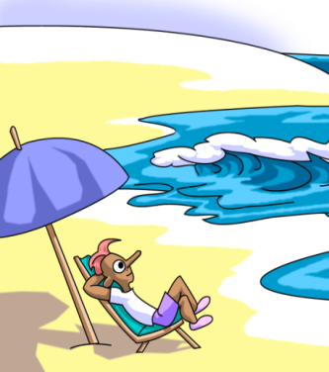
Surfin' U.S.A.
If everybody had an ocean, across the U.S.A.
Then every body'd be surfin' like Californ-i-a
You'd see them wearin' their baggies
huarachi sandals too, a bushy, bushy blonde hairdo...Surfin' USA
You'll catch em' surfin at Del Mar (Inside Outside USA)
Ventura County Line (Inside Outside USA)
Santa Cruz and Tressels (Inside Outside USA)
Australia's Narabine (Inside Outside USA)
All over Manhattan (Inside Outside USA)
and down Doheny way (Inside Outside)
Everybody's gone surfin'...surfin' USA
Everybody's gone surfin'...surfin' USA (2X).........USA!

Slide 4
Tutti Frutti
A-wop bop-a-loo bop a-wop bam boom!
Tutti Frutti au rutti (5X)
I got a gal named Sue, she knows just what to do (2X)
I've been to the east, I've been to the west, but she's the gal that I love best.
I got a gal named Daisy, she almost drives me crazy (2X)
She's a real gone cookie, yes sirree, but pretty little Susy's the gal for me.

Slide 5
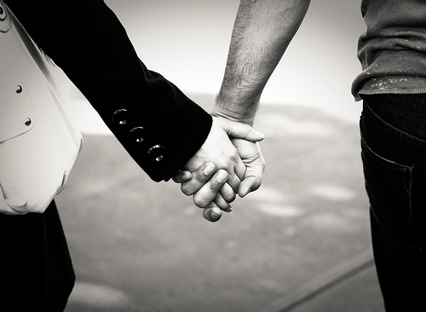
I Want to Hold Your Hand
Oh yeah I'll tell you something, I think you'll understand
When I say that something, I want to hold your hand.
I want to hold your hand (2X)
Oh please, say to me, you'll let me be your man.
And please, say to me, you'll let me hold your hand.
Now let me hold your hand (2X)
And when I touch you I feel happy inside
It's such a feeling that my love...I can't hide (3X)
Yeah you, got that something, I think you'll understand.
When I say that something, I want to to hold you hand.
I want to hold your hand (2X)

Slide 6
Rock and Roll Forever!
Take blues and boogie woogie,
and a little bit of gospel too
Add a little taste of country,
now you know what to do
You got that beat? You got that soul?
You've got rock and roll!
Rock and roll forever, forever rock and roll (2X)
It's here to stay, that's why we say
Rock and roll forever!
We love rock and roll!
Let's Rock! Rock!
Rock and Roll (2X)
We love rock and roll!

